Slide 1


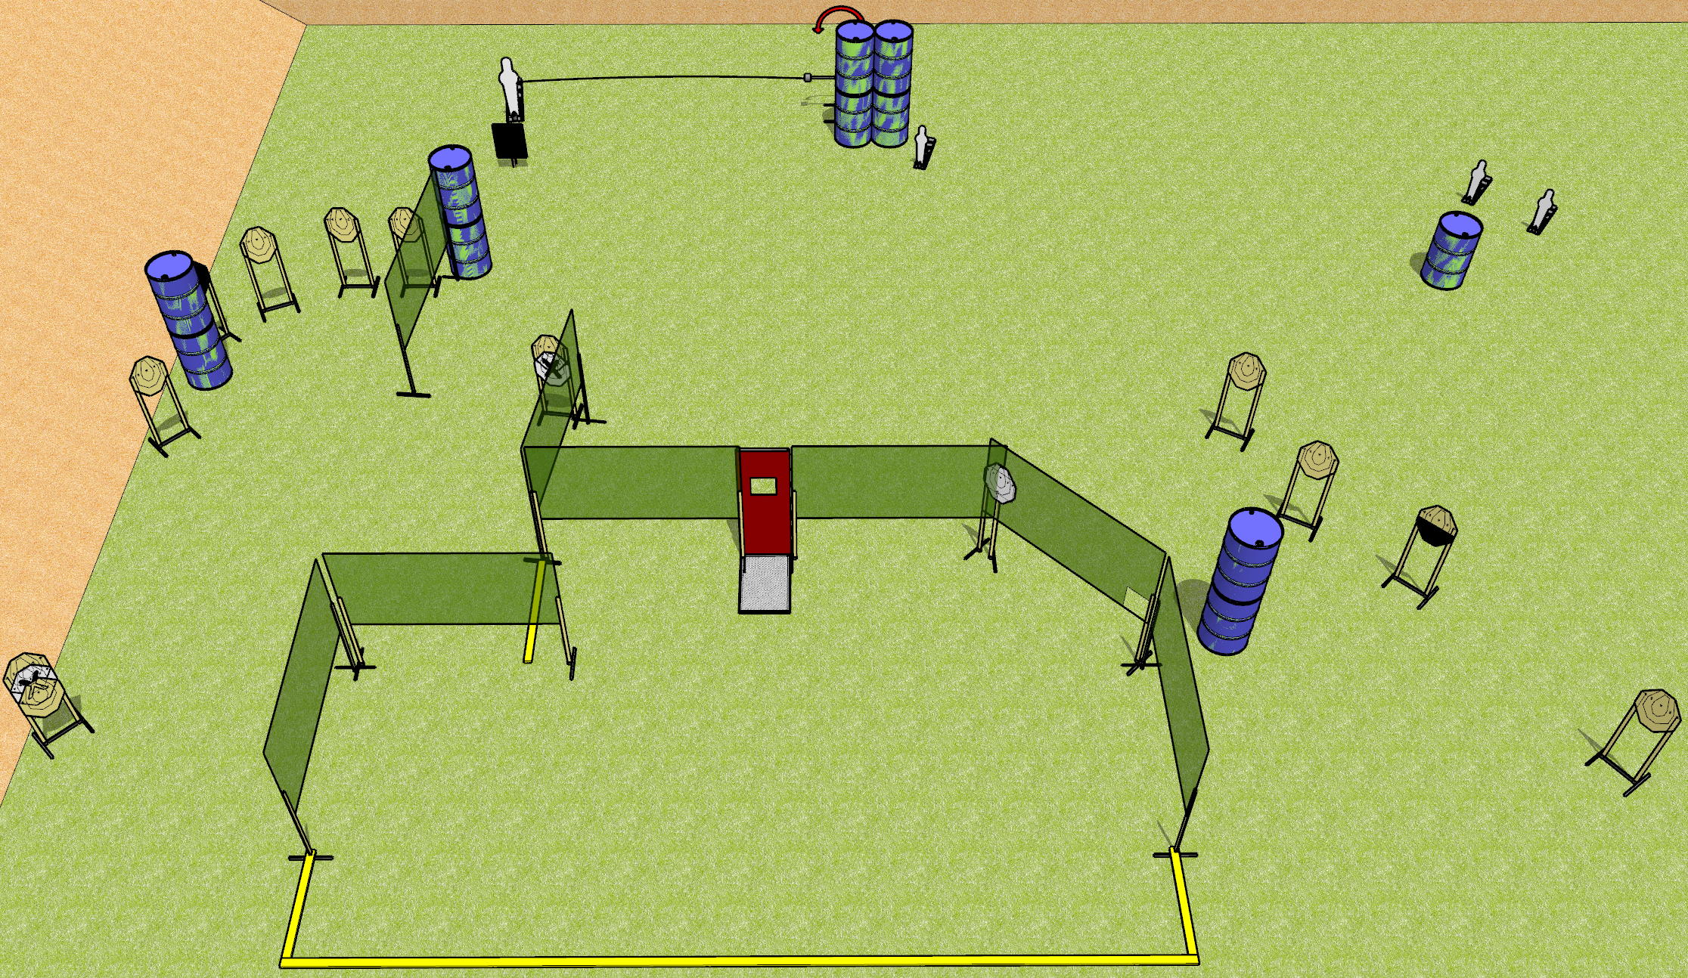
 | Dothan Gun Club – USPSA Match Window to the Soul Course Designer : Drew Coleman
START POSITION : Standing anywhere completely outside the shooting area. Hands relaxed at sides.
GUN READY CONDITION : Pistol loaded and holstered. PCC buttstock on belt, barrel perpendicular to back berm. |  | SCORING: Comstock, 30 rounds TARGETS: 13 paper, 4 Steel SCORED HITS: Best 2 on paper, steel until down START-STOP: Audible, last shot RULES:
STAGE PROCEDURE: Engage targets as they become available from within the fault lines

Slide 2
Window to the Soul
Written Stage Briefing
Ruffle Shuffle is a 30 rounds, 150 point, Comstock Field Course. There are thirteen USPSA targets, one pepper popper, and three mini poppers. The best two hits per target will score. Steel must fall to score. The start signal is audible.
The handgun start position is standing completely outside the shooting area, gun loaded and holstered, wrists below belt.
The PCC start position is standing completely outside the shooting area. Loaded carbine held with both hands, safety on, buttstock on belt, pointed in a safe direction.
Upon start signal, engage targets as they become available from within the fault lines.

